Slide 1
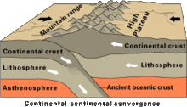
Georgia’s Mountains and Valleys Please pay close attention to the video, you will need to complete an assignment afterward. Notes will be helpful.
This is a graded assignment!

Slide 2
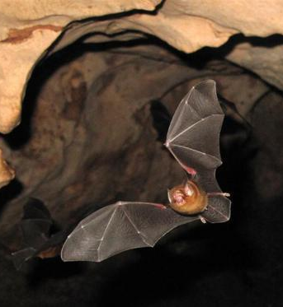
My Cave Journal
1. Create a journal of the sights you might see if you were exploring a cave. Be sure to express feelings and how these sites might affect you. You may pretend you are looking for someone who is lost, or you might pretend you are a geologist who is exploring a cave for the first time.
2. Due at the end of class – Use the graphic organizer provided.
3. Rules: 1: Colorful Cover and Title, 2: Short story about why you are travelling into the mountain (cave), 3: How your journey turned out, 4: What did you see on your journey?
4. 25 points available for each of the above items
Of course it is for a grade!!!

